Slide 1
CHINOOK Music Store
BY
MR. SHELDON LUIS dE NORONHA
06-08-2024

Slide 2
Table of contents
01. Problem Statement
02. Schema & Pre Processing
03. Top Sales Globally
Introduction of Topic and Problems being addressed
Gives as the Structure of data we have worked on
Gives us insight on the Top Selling Tracks, Genres and Artist globally
04. World wide Purchases
06. Purchasing Behaviours
05. Revenue
Gives an insight on the Purchases made by customers internationally
Gives an insight on the monetary trend of Chinook
Gives as insite on the customer purchasing behaviour
07. Churn Rate
06. Strategies & Improvements
Gives an insight on the customer churn rate
In site on the Strategies and Improvements to boost sales

Slide 3
01. Problem Statement

Slide 4
Problem Statement
HIRED AS A DATA ANALYST AT CHINOOK,
TO ANALYZE MUSIC RECORD SALES DATA TO GAIN INSIGHTS AND MAKE RECOMMENDATIONS FOR THE COMPANY'S STRATEGY IN THE PHYSICAL MUSIC MARKET.

Slide 5
02. Schema & Pre Processing

Slide 6
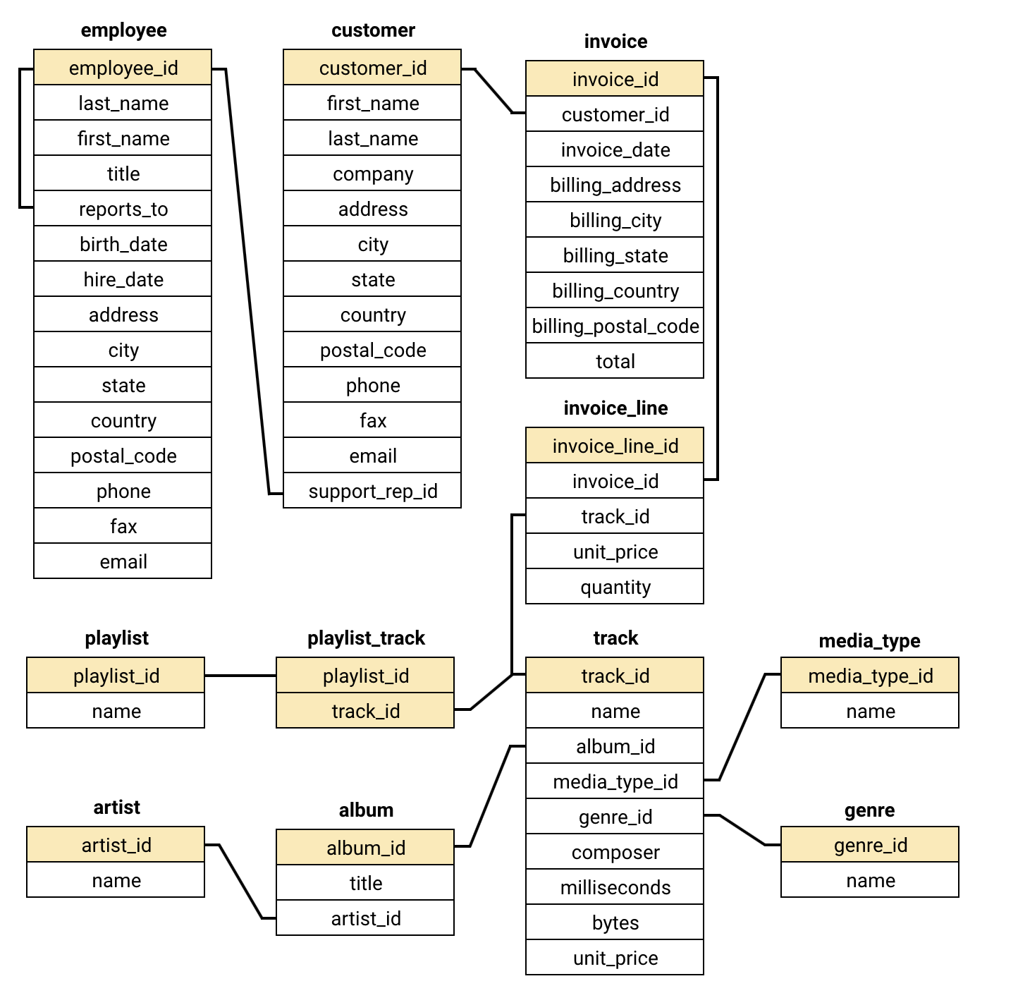
Schema
The schema shows that we working on a Relational Database, where each Data set is linked to the other via keys.

Slide 7
Data Pre Processing
Data Pre processing & Data cleaning are needed to normalize and validate data,
Some of the preprocessing done were
Empty cells: | There are about 440+ empty cells found in the given Data Base. Replaced all the missing values with “NULL” or column equivalent data.
Duplicate values: | Duplicated values due to the multiple purchases by customers which can be resolved/ filtered out by using the “DISTINCT” command

Slide 8
03. Top Sales Globally

Slide 9
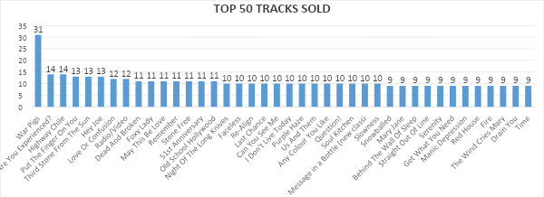
Top Selling Tracks Globally
The track ”War Pigs” is the most sold and is twice the amount of 2nd most sold track.
While tracks like Slowness and so on have a few purchases made nearly 1/3rd the amount of top tracks purchased

Slide 10
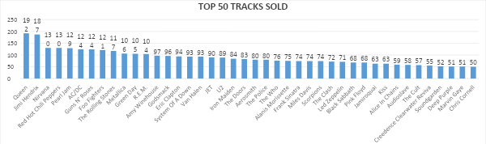
Top Selling Artist Globally
Most of the customers fans of the artist QUEEN at having purchased 192 tracks globally, followed by artist Jimi Hendrix.
While the customer pull for the artist at the other end like Deep Purple and so on is nearly 1/4th of the top purchases made

Slide 11
04. World wide purchases

Slide 12
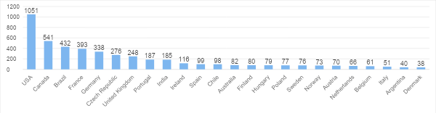
Purchases made in Countries
USA outlets have highest purchases at 1051 which is twice than Purchases made in Canada
While the customer purchases at countries like Argentina and Denmark are merely 4% of those made in USA
Hence USA is the main market for CHINOOK

Slide 13
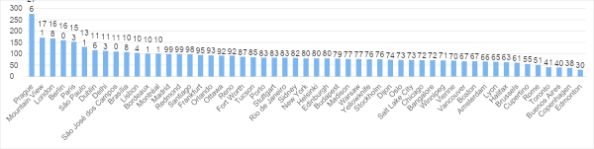
Purchases made in Cities
Prague has the most purchases made at 276 which are 100 more than Purchases made in Mountain View
While the customer purchases at cities like Edmonton and so on are merely 10% of those made in Prague
Hence Prague is the main market for CHINOOK

Slide 14
05. Revenue

Slide 15
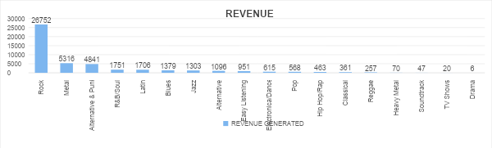
Revenue generated by genres
Rock generates the most Revenue at a incredible 26K
Metal 2nd highest genre revenue at 5k, nearly 5 times less as that of Metal.
While the low Revenue generated in other genres is nearly negligible

Slide 16
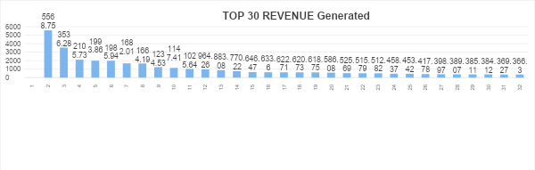
Revenue generated per country per genre
Rock is the highest revenue generating genre in most countries
followed by Metal expect for countries like Brazil, Czech Republic, France and so on where other genres such as Alternative & Punk is prefered

Slide 17
06. Purchasing Behaviour

Slide 18
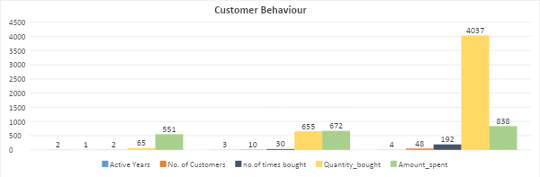
Customer Purchase history
48 customers active for 4 years,
10 customers active for 3 years,
Only one customer was active for only 2 years
Quantities purchased is highest for the most active customers
No much spent amount difference by a single customer and that spent by 10

Slide 19
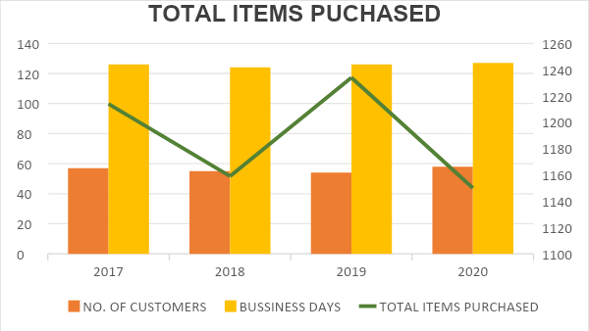
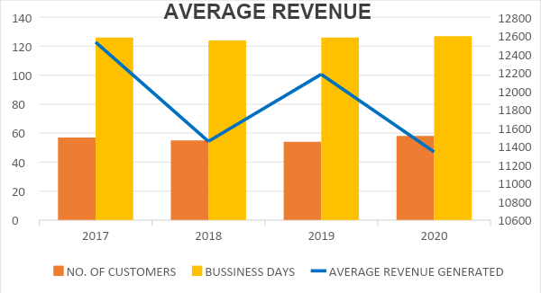
Customer Purchase Trends
No. of Customers on average annually was the same
No. of Business Days the stores had visits on average annually was the same
However there was drop in the total no. of items purchased and average revenue generated for year 2018 and 2020

Slide 20
07. Churn Rate

Slide 21
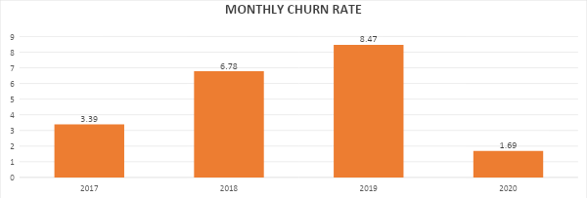
Customer Churn Rates
Churn rate increases annually (2017-2019) which isn’t a good sign as increases implies losing customers as compared to prev month
2020 has the most number of customers who returned and a few who did not.
The Churn rate of customers over the entire 4 years period is 1.69

Slide 22
08. Strategies & Improvements

Slide 23
Strategies
Providing Promotions to top sold genres, to improve customer sales
Discount days every week so as to attract customers both old and new
Having Advertisements would boost sales and provide awareness
The store can also sell tracks bought together as sets to boost sales and revenue.

Slide 24
Conclusion & Observations
WAR PIGS was the most Sold Track
QUEEN was the most Preferred Artist
The country which generated Highest Revenue for CHINOOK is USA
The city which generated Highest Revenue for CHINOOK is Prague
ROCK, METAL and ALTERNATIVE & PUNK are Top Sold genres
The genre Rock generated highest revenue for CHINOOK
48 customers active for 4 years, 10 customers active for 3 years,
Only one customer was active for only 2 years
Year 2020 has the most number of customer

Slide 25
Thank You

